Slide 1
State chart diagram
18CS202J OBJECT ORIENTED DESIGN AND PROGRAMMING

Slide 2
State diagram
A state diagram is used to represent the condition of the system or part of the system at finite instances of time. It’s a behavioural diagram and it represents the behaviour using finite state transitions. State diagrams are also referred to as State machines and State-chart Diagrams.

Slide 3
Uses of state chart diagram
State chart diagrams are useful to model reactive systems
-Reactive systems can be defined as a system that responds to external or internal events.
• State chart diagram describes the flow of control from one state to another state.

Slide 4
Purpose
Following are the main purposes of using State chart diagrams:
To model dynamic aspect of a system.
To model life time of a reactive system.
To describe different states of an object during its life time.
Define a state machine to model states of an object.

Slide 5
Difference between state diagram and flowchart
The basic purpose of a state diagram is to portray various changes in state of the class and not the processes or commands causing the changes.
However, a flowchart on the other hand portrays the processes or commands that on execution change the state of class or an object of the class.

Slide 6
When to use State charts
So the main usages can be described as:
To model object states of a system.
To model reactive system. Reactive system consists of reactive objects.
To identify events responsible for state changes.
Forward and reverse engineering.

Slide 7
How to draw state charts
Before drawing a State chart diagram we must have clarified the following points:
Identify important objects to be analysed.
Identify the states.
Identify the events.

Slide 8

Elements of state chart diagrams
Initial State: This shows the starting point of the state chart diagram that is where the activity starts.

Slide 9

Elements of state chart diagrams
State: A state represents a condition of a modelled entity for which some action is performed. The state is indicated by using a rectangle with rounded corners and contains compartments

Slide 10
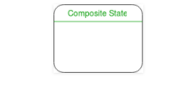
Elements of state chart diagrams
Composite state – We use a rounded rectangle to represent a composite state also. We represent a state with internal activities using a composite state.

Slide 11
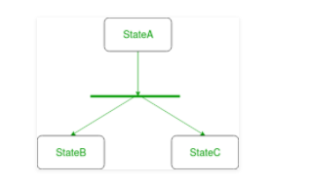
Elements of state chart diagrams
Fork – We use a rounded solid rectangular bar to represent a Fork notation with incoming arrow from the parent state and outgoing arrows towards the newly created states. We use the fork notation to represent a state splitting into two or more concurrent states.

Slide 12
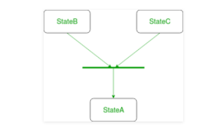
Elements of state chart diagrams
Join – We use a rounded solid rectangular bar to represent a Join notation with incoming arrows from the joining states and outgoing arrow towards the common goal state. We use the join notation when two or more states concurrently converge into one on the occurrence of an event or events.

Slide 13
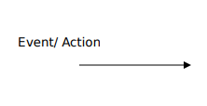
Elements of state chart diagrams
Transition: It is indicated by an arrow. Transition is a relationship between two states which indicates that Event/ Action an object in the first state will enter the second state and performs certain specified actions.

Slide 14

Elements of state chart diagrams
Transition – We use a solid arrow to represent the transition or change of control from one state to another. The arrow is labelled with the event which causes the change in state.

Slide 15
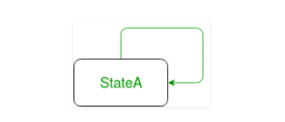
Elements of state chart diagrams
Self transition – We use a solid arrow pointing back to the state itself to represent a self transition. There might be scenarios when the state of the object does not change upon the occurrence of an event. We use self transitions to represent such cases.

Slide 16
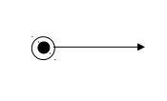
Elements of state chart diagrams
Final State: The end of the state chart diagram is represented by a solid circle surrounded by a circle.

Slide 17
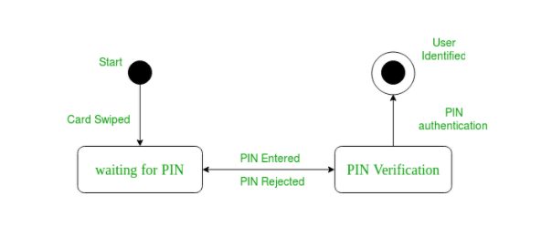
Example state chart for ATM card PIN Verification

Slide 18
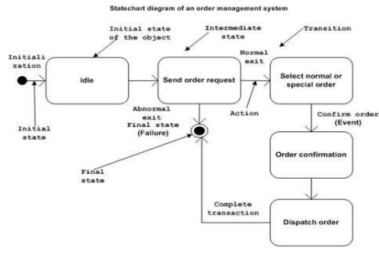
Example state chart for order management system

